Slide 1


Alexa Gal
March 7, 2022

Slide 2

Outline
Executive Summary
Introduction
Methodology
Results
Conclusion
Appendix

Slide 3
Executive Summary
Summary of methodologies
Data Collection using API
Data Collection using Web Scraping
Data Wrangling
Exploratory Data Analysis with SQL
Exploratory Data Analysis with Data Visualization
Interactive Visual Analytics with Folium
Machine Learning Prediction
Summary of all results
Exploratory Data Analysis
Interactive analytics
Predictive analytics

Slide 4
Introduction
Project background and context
SpaceX has significantly lower costs (62million USD) of launching a rocket compared to its competitors (up to 165million USD). The major advantage of SpaceX is the reuse of the first stage. We can calculate the cost of a launch by determining if the first stage is successful. This information helps if there is competition against SpaceX for bidding for a contract.
Problems you want to find answers
What are the contributing factors to successfully land a rocket?
How do these factors contribute to the success rate of landing a rocket?
What are the factors of a successful rocket landing?

Slide 5

Section 1

Slide 6
Methodology
Executive Summary
Data collection methodology:
Collected data using SpaceX API and Web Scraping from Wikipedia
Perform data wrangling
Applied one-hot encoding to categorical features
Perform exploratory data analysis (EDA) using visualization and SQL
Perform interactive visual analytics using Folium and Plotly Dash
Perform predictive analysis using classification models
How to build, tune, evaluate classification models

Slide 7
Data Collection
Collected data sets using:
Get request to SpaceX API
.json() function call turned into pandas dataframe using j.son_normalize()
Cleaned data, checked for and filled in missing values as needed
Used BeautifulSoup to web scrape from Wikipedia
Extracted launch records, parsed the HTML table and converted into pandas dataframe

Slide 8
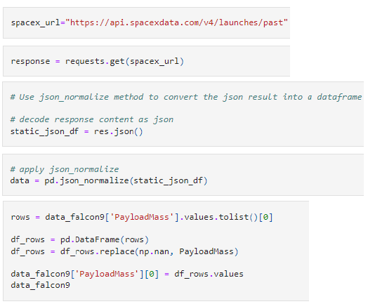
Data Collection – SpaceX API
Made a get request to the SpaceX API, then cleaned the data. Then, did some basic data wrangling and formatting.
GitHub URL:
https://github.com/fridgeraider1/FinalProject/blob/9ab2403eb700d7b9c772abaa9ba38e52aac263e6/Week%201/API.ipynb
Place your flowchart of SpaceX API calls here

Slide 9
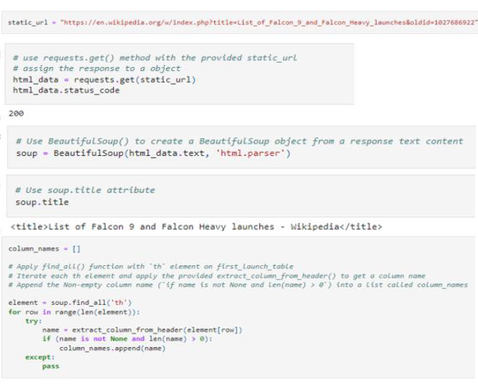
Data Collection - Scraping
Used BeautifulSoup web scraping to extract a Falcon 9 launch records HTML table from Wikipedia. Then, parsed the table and converted it into a Pandas data frame.
GitHub URL:
https://github.com/fridgeraider1/FinalProject/blob/a98bbd3a9e017b7a3333f7fce8a103429cd0b538/Web%20Scraping.ipynb
Place your flowchart of web scraping here

Slide 10
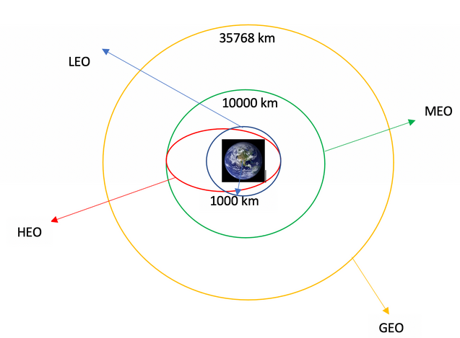
Data Wrangling
Performed exploratory data analysis and determined training labels. Then, calculated the number of occurrence of each orbit and the number of occurrence of mission outcome per orbit type. Then, created a landing outcome label from Outcome column.
Add the GitHub URL :
https://github.com/fridgeraider1/FinalProject/blob/a98bbd3a9e017b7a3333f7fce8a103429cd0b538/Wrangling.ipynb

Slide 11
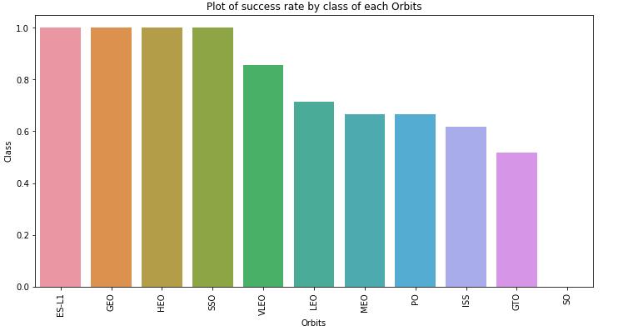
EDA with Data Visualization
Plotted a bar chart to try to find which orbits have high success rate.
GitHub URL:
https://github.com/fridgeraider1/FinalProject/blob/a98bbd3a9e017b7a3333f7fce8a103429cd0b538/Data%20Visualization.ipynb

Slide 12
EDA with SQL
Loaded the dataset into the corresponding table in a Db2 database using PostgreSQL. Then created a table, displayed unique launch sites in the space mission with the string 'CCA', displayed total payload mass carries by boosters launched by NASA and average payload mass carried by booster version F9. V1.1. Then, listed date of first successful landing outcome in ground pad was achieved. Listed names of the boosters which have success in drone ship and have payload mass greater than 4000 but less than 6000. Listed the total number of successful and failure mission outcomes. Using a subquery, listed names of the booster_versions with max payload mass and listed failed landing_outcomes in drone ship for year 2015. Finally, ranked the count of landing outcomes in descending order.
GitHub URL:
https://github.com/fridgeraider1/FinalProject/blob/a98bbd3a9e017b7a3333f7fce8a103429cd0b538/SQL.ipynb

Slide 13
Build an Interactive Map with Folium
Marked all launch sites on the map along with the success or failed launches for each site on the map to see which sites have high success rate. Then, calculated the distances between a launch site to its proximities.
GitHub URL:
https://github.com/fridgeraider1/FinalProject/blob/a98bbd3a9e017b7a3333f7fce8a103429cd0b538/Launch%20Sites%20Locations.ipynb

Slide 14
Build a Dashboard with Plotly Dash
Built an interactive dashboard using Plotly Dash
Plotted pie charts to show the total launches of sites
Plotted scatter graph to show the relationship between outcome and payload mass for different booster versions.

Slide 15
Predictive Analysis (Classification)
Used NumPy and pandas to create a column for the class, standardize the data in X and used function_train_test_split to split into training data and test data. Then, used logistic regression.Then, created decision tree classifier object to find best parameters. Used K nearest neighbors object to find best performing classification model.
GitHub URL:
https://github.com/fridgeraider1/FinalProject/blob/a98bbd3a9e017b7a3333f7fce8a103429cd0b538/Machine%20Learning%20Prediction.ipynb

Slide 16
Results
Exploratory data analysis results
Interactive analytics demo in screenshots
Predictive analysis results

Slide 17

Section 2

Slide 18
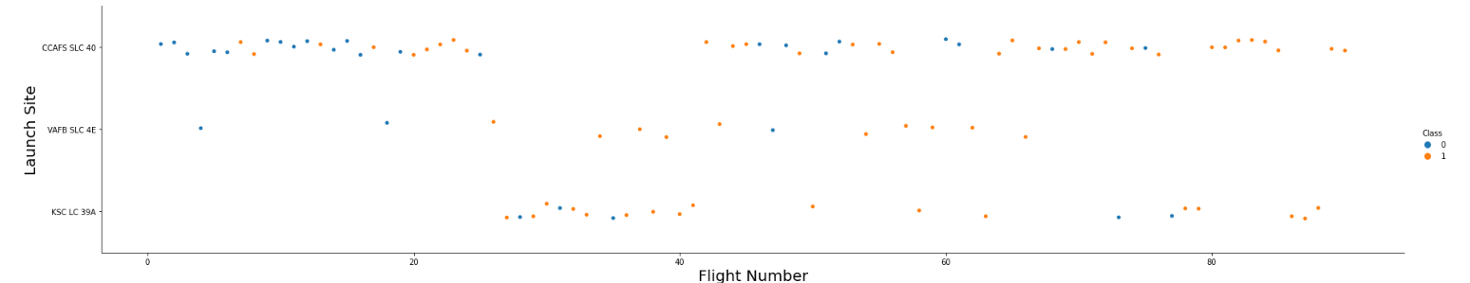
Flight Number vs. Launch Site
The success rate at a launch site directly correlates with the flight amount at a launch site. The higher the flight amount, the higher success rate is.

Slide 19
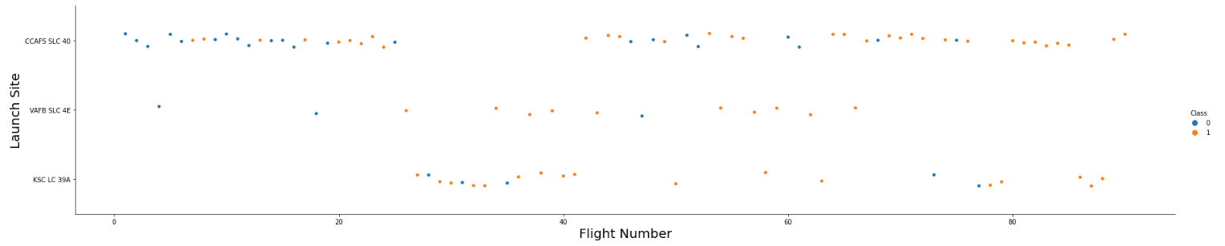
Payload vs. Launch Site
As the payload mass increases, the success rate increases too.

Slide 20
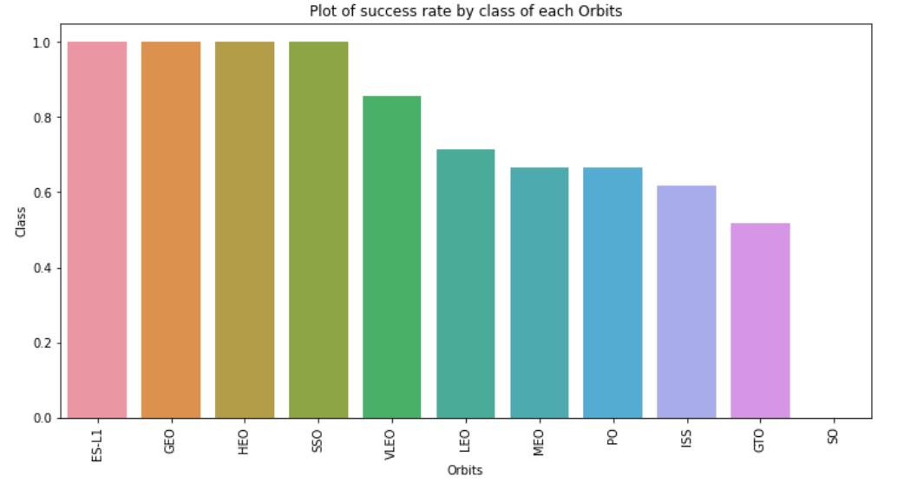
Success Rate vs. Orbit Type
ES-L1, GEO, HEO, SSO, and VLEO are the Orbits that have high success rate. The SO has the least success rate amongst the orbits.

Slide 21
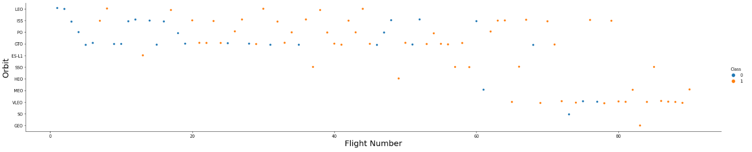
Flight Number vs. Orbit Type
Success appears related to the number of flights in the LEO orbit. No relationship between flight number when in GTO orbit.

Slide 22
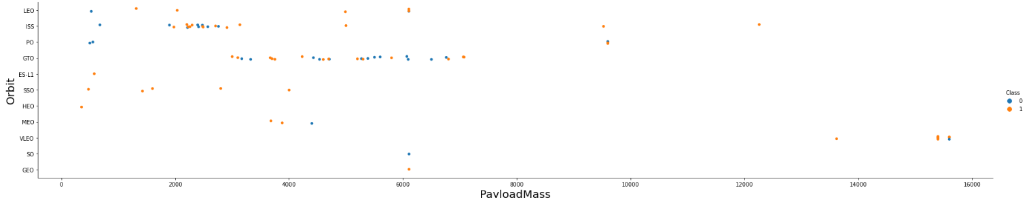
Payload vs. Orbit Type
With heavy payloads the successful landing or positive landing rate are more for Polar, LEO and ISS.
Can't say the same for GTO as both positive landing rate and negative landing (unsuccessful mission) are both present.

Slide 23
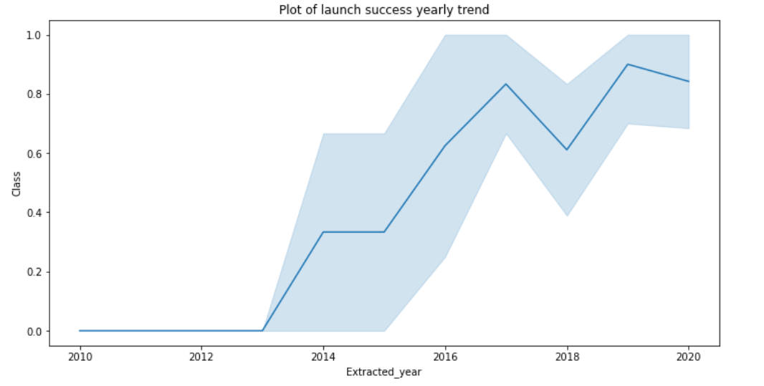
Launch Success Yearly Trend
Success rate since 2013 kept increasing till 2020.

Slide 24
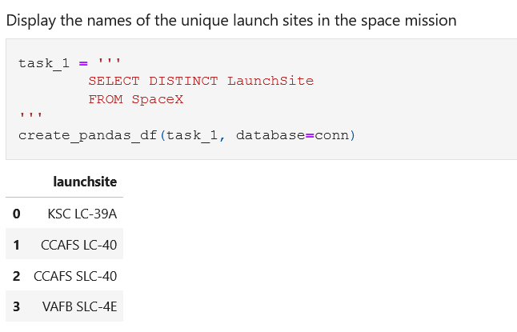
All Launch Site Names
Used SELECT DISTINCT to display the names of the unique launch sites in the space mission.

Slide 25
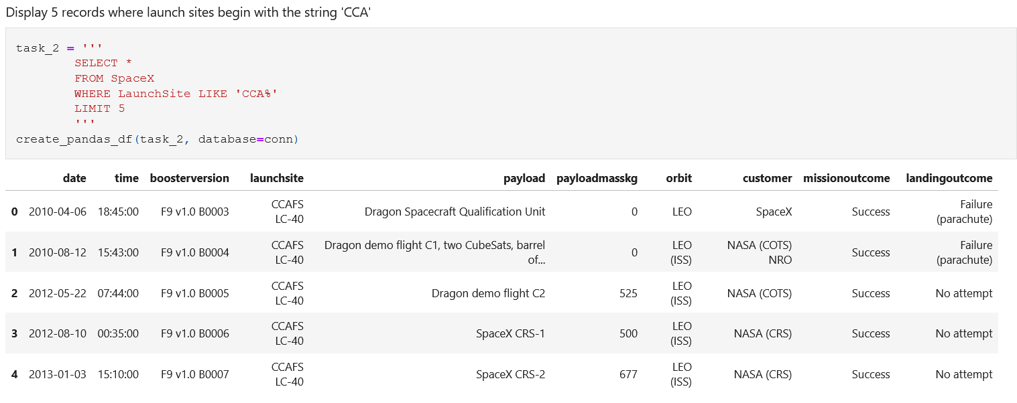
Launch Site Names Begin with 'CCA'
Used the below query to display 5 records where launch sites begin with the string 'CCA'

Slide 26
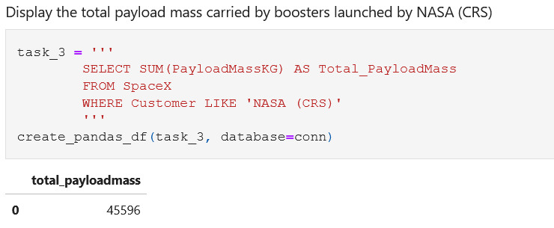
Total Payload Mass
Calculated the total payload mass carried by boosters launched by NASA using the below query.

Slide 27
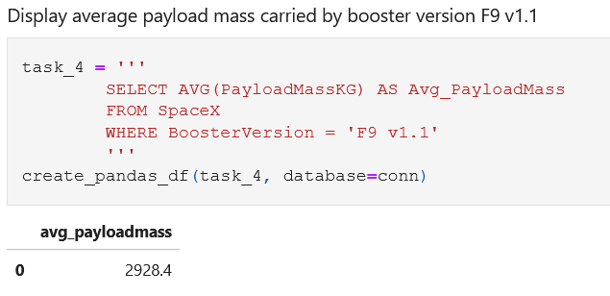
Average Payload Mass by F9 v1.1
Calculated the average payload mass carried by booster version F9 v1.1 by using the below query.

Slide 28
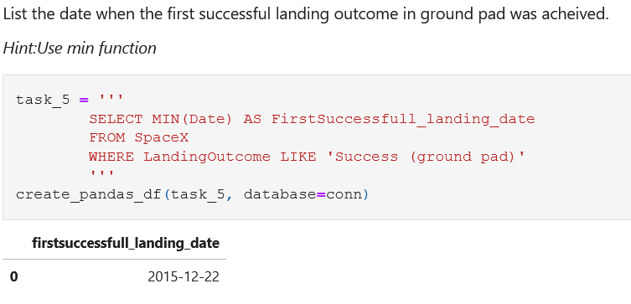
First Successful Ground Landing Date
Listed the date when the first successful landing outcome in ground pad was achieved using the below query and the MIN() function.

Slide 29
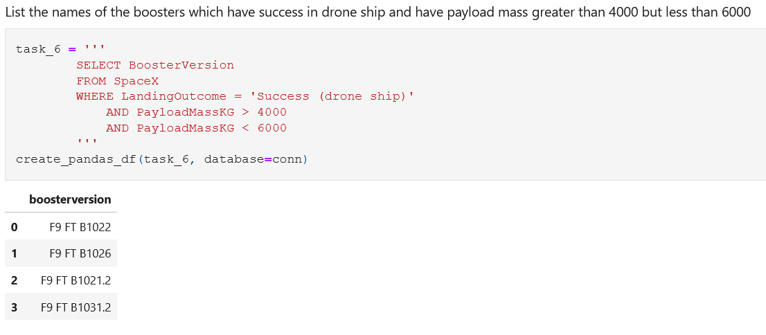
Successful Drone Ship Landing with Payload between 4000 and 6000
Calculated the names of the boosters which have success in drone ship and have payload mass greater than 4000 but less than 6000 using the below query.​

Slide 30
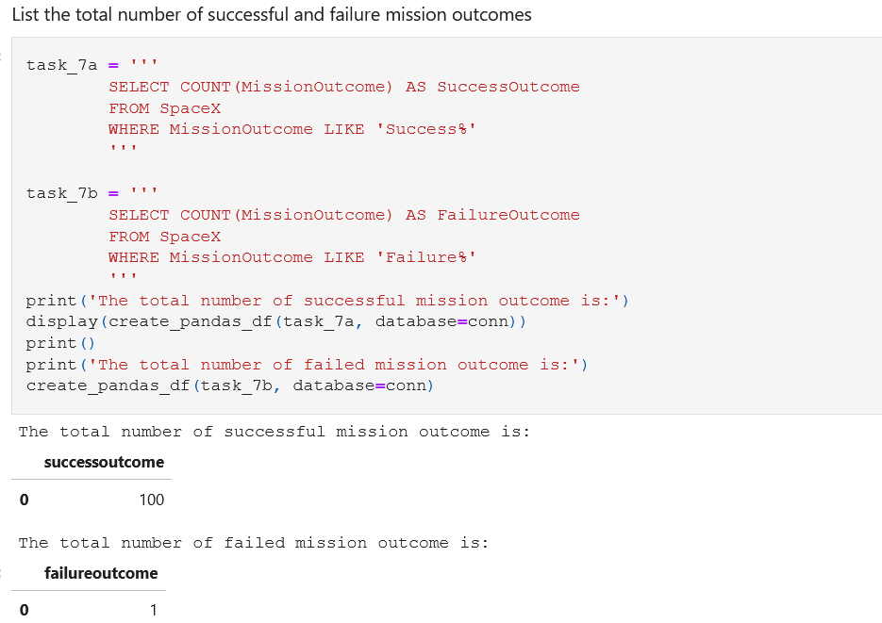
Total Number of Successful and Failure Mission Outcomes
Used wildcard '%' to help list the total number of successful and failed mission outcomes.

Slide 31
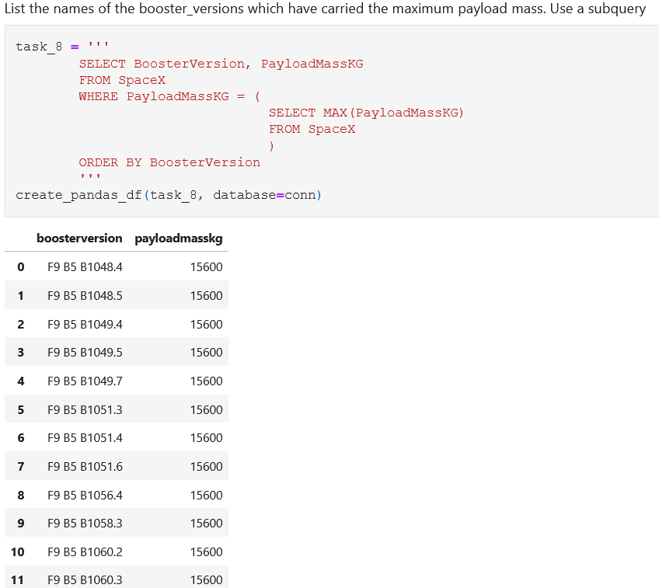
Boosters Carried Maximum Payload
Listed the names of the booster_versions which have carried the max payload mass using the below subquery using MAX() function.

Slide 32
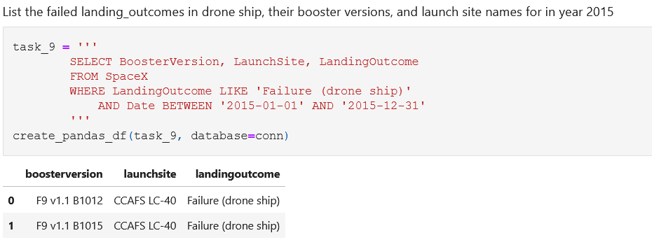
2015 Launch Records

Slide 33
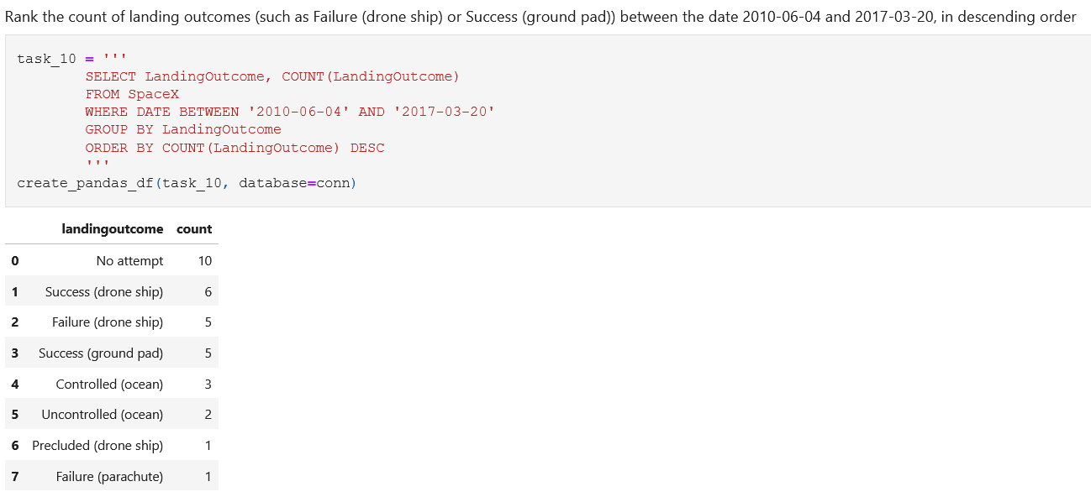
Rank Landing Outcomes Between 2010-06-04 and 2017-03-20

Slide 34

Section 3

Slide 35
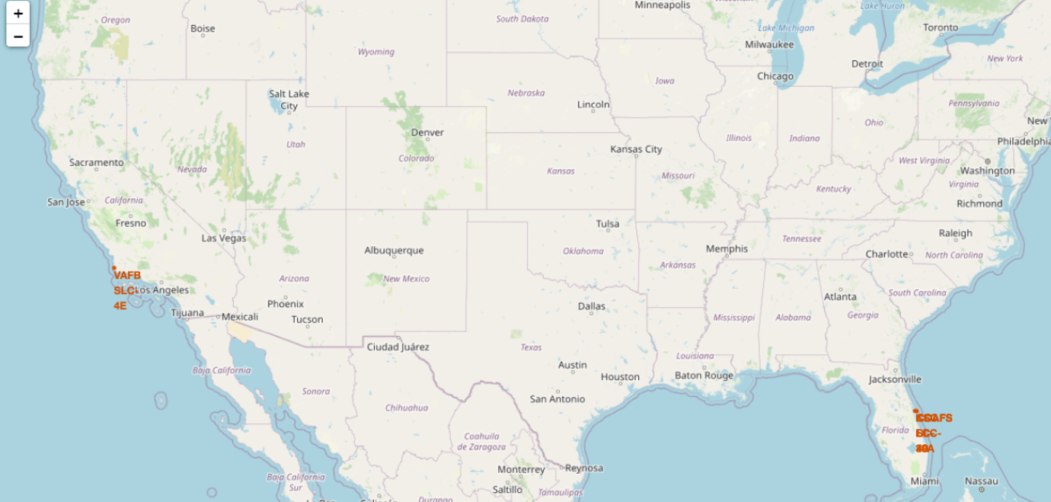
All Launch Sites Locations with Folium
There are two launch sites located in the U.S.A - Florida and California.

Slide 36
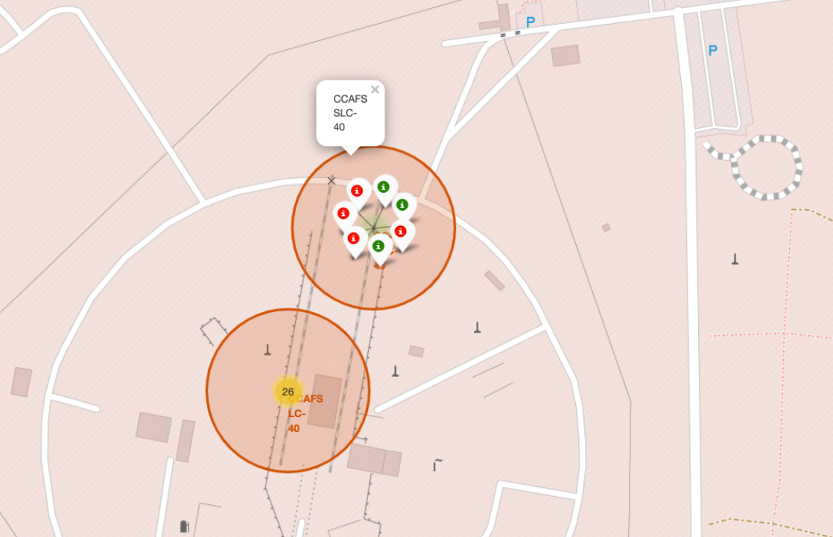
Launch sites with markers showing color labels
Green marker – successful launches
Red marker – failed launches

Slide 37
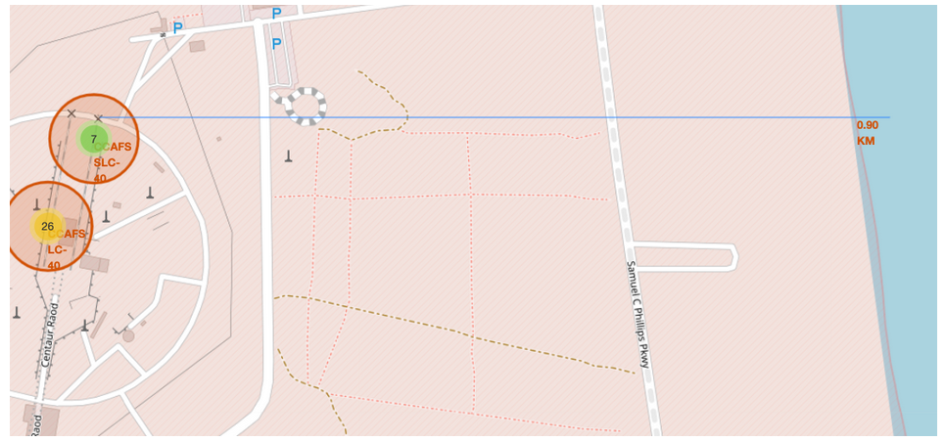
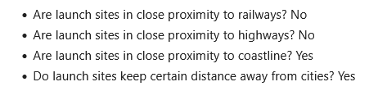
Launch Site Distances

Slide 38

Section 5

Slide 39
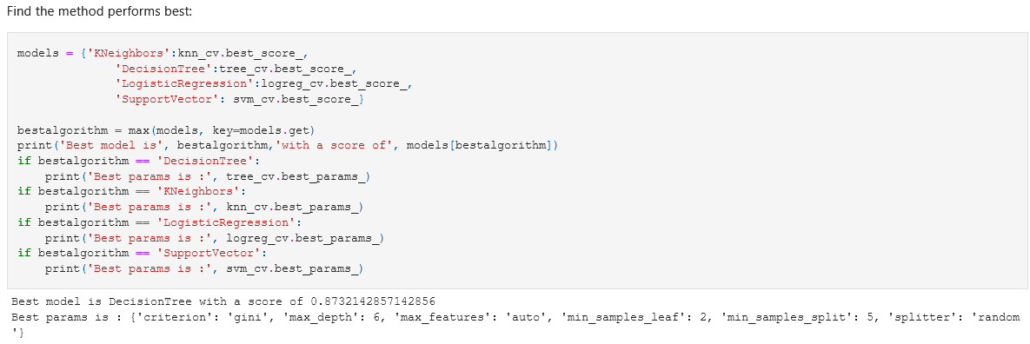
Classification Accuracy
The best model is the Decision Tree which has the highest classification accuracy.

Slide 40
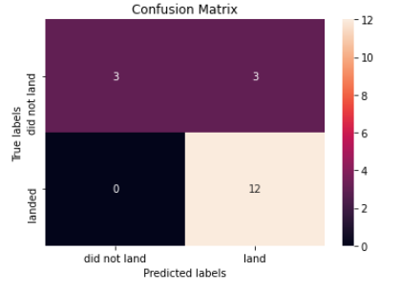
Confusion Matrix
The confusion matrix classifier can distinguish between different classes. Problem with it is the false positives.

Slide 41
Conclusions
As the flight amount increases, the success rate increases at a launch site.
As the payload mass increases, the success rate increases too.
Launch success rate increased from 2013 until 2020.
Orbits E-L1, GEO, HEO, SSO, VLEO had the most success rate.
The SO has the least success rate amongst the orbits.
KSC LC-39A had the most successful launches at any sites.
The best machine learning algorithm is the decision tree classifier for this case because it has the highest classification accuracy.

Slide 42


